Slide 1
Oracle JVM GC Tuning

Slide 2
Agendia
Tuning Measurement
Memory Generations
Collectors
JConsole

Slide 3
Tuning Measurement
Throughput
Percentage of total time that is not spent in GC
Tested by client load generator
Can be monitored by jconsole.exe
Pauses
The times when application does not response
Use -verbose:gc, -XX:+PrintGCDetails options
[GC [DefNew: 78336K->8704K(78336K), 0.0431954 secs] 138658K->135420K(252416K), 0.0432194 secs] [Times: user=0.05 sys=0.00, real=0.04 secs]
[GC [DefNew: 78336K->8703K(78336K), 0.0405186 secs][Tenured: 195971K->196151K(196160K), 0.0086531 secs] 205052K->204675K(274496K), [Perm : 2493K->2493K(21248K)], 0.0497288 secs] [Times: user=0.03 sys=0.02, real=0.05 secs]
Footprint
The working set of a process
Measured by OS tool (such as, task manager)

Slide 4
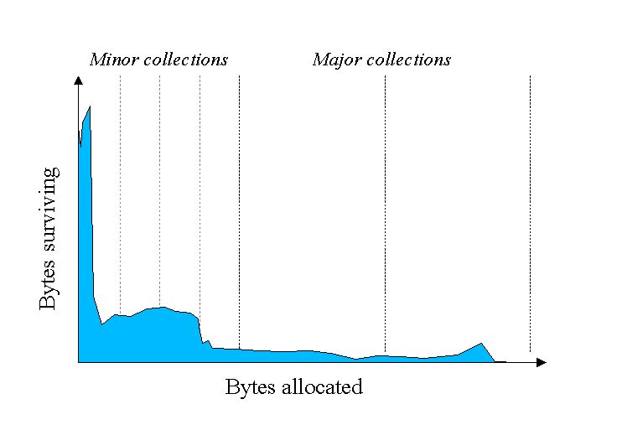
Memory Generations
Most of objects do not live long
Memory is managed by generation

Slide 5
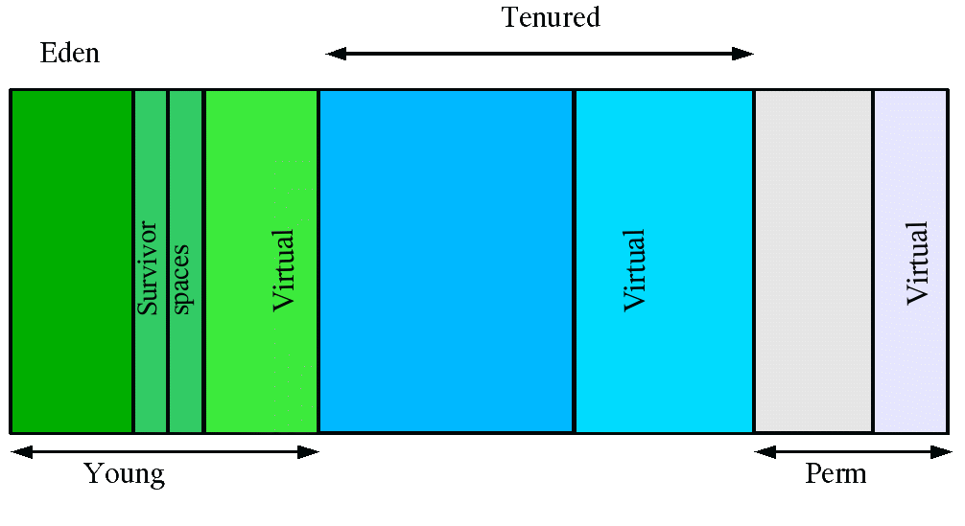
Memory Generations
Generations
New object is allocated in young generation.
Tenured is the old generation. Objects that live long are move to this generation.
Classes and methods are stored in permanent generation.

Slide 6
Memory Generations
Young Generation
One eden and two survivor spaces.
Most of the new objects are allocated in eden space.
One of the survivors is empty.
Minor GC is caused when it is filled up.
During minor GC,
live objects are copied to the empty survivor space.
The eden will be cleared.
These two survivor spaces are swaped.
Old objects are promoted to tenured generation
eden
survivor
survivor
eden
survivor
survivor
eden
survivor
survivor

Slide 7
Memory Generations
Tenured Generation
Store the old objects.
Major GC is caused when it is filled up.
Collector will mark and reclaim the dead objects.
Memory compaction is needed.
tenured
tenured
tenured
tenured

Slide 8
Memory Generations
Generation Sizing
-Xms/-Xmx: the min/max size of heap (young generation + tenured generation).
-XX:NewRatio: The ratio between size of tenured and young generation.
-XX:NewSize/-XX:MaxNewSize the min/max size of young generation.
-XX:SurvivorRatio: ratio between eden and a survivor space

Slide 9
Memory Generations
Recommendations For Sizing
Set -Xmx to the max memory you can afford. Grant as much memory as possible until you have problem with pauses.
Set -Xms = -Xmx to remove the heap sizing decision from JVM.
Increase the size of young generation. Keep the tenured generation large enough to hold the long live objects.
If survivor space is always full, increase its size to prevent copying collection overflows.
If number of times of minor GC <= number of times of major GC, reduce/increase young/tenured generation.

Slide 10
Collectors
Serial Collector
Use single thread.
More efficient since no communication overhead between threads.
Best-suited to single processor machines with small data.
Enabled with the option -XX:+UseSerialGC.
Log message:
[GC [DefNew: 78336K->8704K(78336K), 0.0399596 secs] 138658K->135420K(252416K), 0.0399904 secs] [Times: user=0.05 sys=0.00, real=0.04 secs]
[GC [DefNew: 78336K->8703K(78336K), 0.0468350 secs][Tenured: 195971K->196151K(196160K), 0.0071836 secs] 205052K->204675K(274496K), [Perm : 2493K->2493K(21248K)], 0.0546892 secs] [Times: user=0.02 sys=0.03, real=0.05 secs]

Slide 11
Collectors
Serial Collector
Use serial collector when:
Application has small data set (less than 100M)
Single CPU core
No requirement for pause time

Slide 12
Collectors
Parallel Collector
Multi-threads are use to speed up GC
Enabled with options:
“-XX:+UseParallelGC” - only minor GC
“-XX:+UseParallelOldGC - both minor and major GC
Use the “XX:ParallelGCThreads=<N>” to set numbers of threads.
Higher - Higher throughput and shorter pause time
Lower – Lower fragmentation effect (during promotion from young to tenured)
Log messages
[GC [PSYoungGen: 130560K->10870K(141440K)] 257500K->256752K(418432K), 0.0424194 secs] [Times: user=0.06 sys=0.11, real=0.04 secs]
[Full GC [PSYoungGen: 10870K->0K(141440K)] [ParOldGen: 245881K->256631K(492352K)] 256752K->256631K(633792K) [PSPermGen: 2675K->2675K(21248K)], 0.0206622 secs] [Times: user=0.03 sys=0.00, real=0.02 secs]

Slide 13
Collectors
Parallel Collector
Use parallel collector when:
Multi-processors are available
Throughput is more important than pause time

Slide 14
Collectors
Concurrent Collector
Minor GC is the same as parallel collector
Designed for shorter pause time for major GC
Enabled with “-XX:+UseConcMarkSweepGC” option
GC life cycle
Initial mark pause - mark objects that are reachable from root directly
Concurrent tracing - Trace all reachable objects
Concurrent pre-clean – Prepare for remark pause
Remark pause - find the missed unreachable objects
Concurrent sweeping - collect the unreachable objects
Concurrent reset - prepare for next GC
No compaction

Slide 15
Collectors
Concurrent Collector
Log messages:
[GC [1 CMS-initial-mark: 472489K(557220K)] 481284K(635556K), 0.0000690 secs] [Times: user=0.00 sys=0.00, real=0.00 secs]
[CMS-concurrent-mark: 0.013/0.013 secs] [Times: user=0.01 sys=0.00, real=0.01 secs]
[CMS-concurrent-preclean: 0.001/0.001 secs] [Times: user=0.00 sys=0.00, real=0.00 secs]
[GC[YG occupancy: 9983 K (78336 K)][Rescan (parallel) , 0.0002518 secs][weak refs processing, 0.0000112 secs][scrub string table, 0.0000253 secs] [1 CMS-remark: 472489K(557220K)] 482473K(635556K), 0.0003239 secs] [Times: user=0.00 sys=0.00, real=0.00 secs]
[CMS-concurrent-sweep: 0.001/0.001 secs] [Times: user=0.00 sys=0.00, real=0.00 secs]
[CMS-concurrent-reset: 0.004/0.004 secs] [Times: user=0.00 sys=0.00, real=0.00 secs]

Slide 16
Collectors
Concurrent Collector
Failure
Happen when GC cannot be finished before tenured is full
Application threads are stopped until GC is completed
JVM start GC base on recent history to prevent failure
Adjust -XX:CMSInitiatingOccupancyFraction=<N> if failure happen often
Incremental Mode
It can reduce pause time by dived work into small chunks
It also work for machine with 1 or 2 processors
Enabled with “-XX:+CMSIncrementalMode” option
Use “-XX:CMSIncrementalDutyCycle=<N>” to control the time can be used between 2 minor GC

Slide 17
Collectors
Concurrent Collector
Use concurrent collector when:
Pause time is more important than throughput
The application has a large data set for long live objects

Slide 18
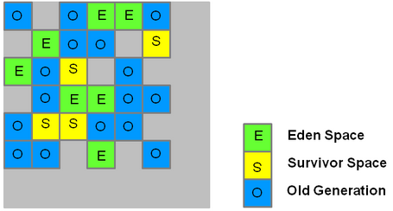
Collectors
Garbage-First(G1) Collector
Available when JDK 1.7 update 4 was released.
It meets pause time goals with high probability, while achieving high throughput
The heap is partitioned into a set of equal-sized heap regions

Slide 19




Collectors
Garbage-First(G1) Collector
Young generation GC steps

Slide 20



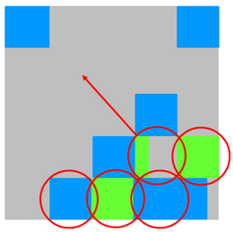

Collectors
Garbage-First(G1) Collector
Tenured generation GC steps
Initial Marking
Concurrent Marking
Remark
Copying/Cleanup
End

Slide 21
Collectors
Garbage-First(G1) Collector
Log messages
[Ext Root Scanning (ms): Avg: 1.7 Min: 0.0 Max: 3.7 Diff: 3.7] [Eden: 818M(818M)->0B(714M) Survivors: 0B->104M Heap: 836M(4096M)->409M(4096M)]
1.729: [GC pause (young) 46M->35M(1332M), 0.0310029 secs]

Slide 22
Collectors
Garbage-First(G1) Collector
Evacuation failure
A promotion failure that happens when a JVM runs out of heap regions
“to-space overflow” will be shown in log when it happen
It will happen for either survivors and promoted objects
Increase -XX:G1ReservePercent to increase the reserved memory.
Best practice
Do not set young generation size via -Xmn
Set XX:MaxGCPauseMillis= 90% * dead line

Slide 23
Collectors
Garbage-First(G1) Collector
Options:
-XX:+UseG1GC - enable G1 collector
-XX:MaxGCPauseMillis=<n> - the goal of max pause time
-XX:ConcGCThreads=<n> - no of threads for concurrent GC
XX:InitiatingHeapOccupancyPercent =<n> - Percentage of the (entire) heap occupancy to start a concurrent GC cycle

Slide 24
Collectors
Garbage-First(G1) Collector
Compare with other collectors
Footprint is bigger
The size of young/tenured generation is dymamic
Compare with parallel collector
Parallel collector – do compaction in the whole heap
G1 collector – do compaction in the selected regions
Compare with concurrent collector
Concurrent collector – no compaction
G1 collector – Do compaction within the user defined pause times.
Use G1 collector when:
The application has a very large data set(>= 6G)
The rate of object allocation rate or promotion varies significantly.
The application need garbage collection or compaction pauses (<= 0.5 second)

Slide 25
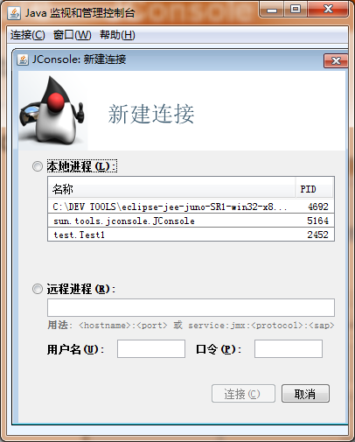
JConsole
Start JConsole
Run {JDK}\bin\jconsole.exe
Connect JVM

Slide 26
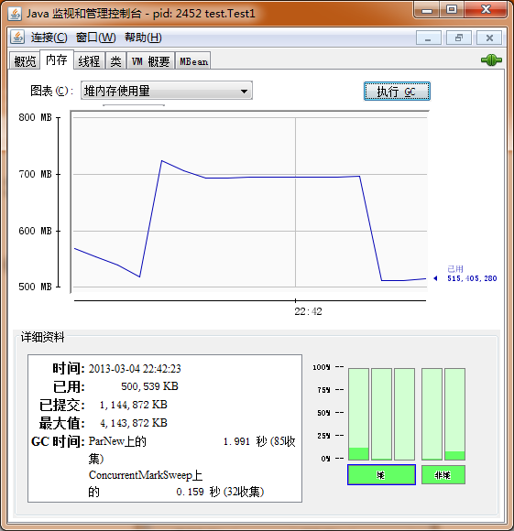
JConsole
Memory monitoring

Slide 27
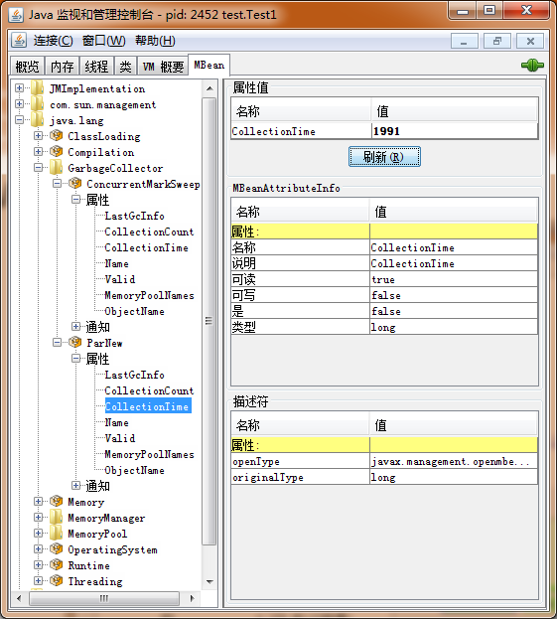
JConsole
Mbeans for collectors

Slide 28
Q & A

